Slide 1
Fundamentos de deep learning
MSc. Israel Chaparro – Embajador Universitario e Instructor Certificado

Slide 2
Agenda
Historia de la IA
La revolución del aprendizaje profundo
Qué es el aprendizaje profundo
Cómo el aprendizaje profundo está transformando el mundo
Visión general del curso
Primer ejercicio

Slide 3
Historia de la ia
Notes:
Deep learning is a subset of a wider field called Artificial Intelligence. We won’t try to teach you about the whole field, but let’s start with a bit of history.

Slide 4
Inicio de la inteligencia artificial
Los ordenadores están hechos en parte para completar tareas humanas
Al principio, la inteligencia generalizada parecía posible
Resultó ser más difícil de lo esperado
Notes:
Humans have been trying to teach computers to perform tasks since their invention. It’s sort of the purpose of a computer, to do something at the level, or beyond what a human can do
Early in the days of computers, many people were convinced that they would achieve human level intelligence within a few decades
It turned out that generalized human intelligence was beyond the grasp of computers at that time (although today, we’re starting to see systems that look a whole lot like human intelligence)

Slide 5
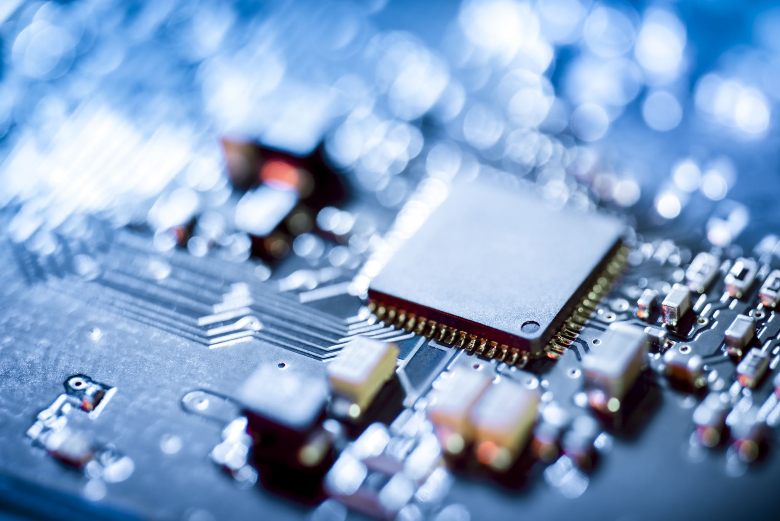
Primeras redes neuronales
Inspirado en la biología
Creado en los años 50
Superada por la arquitectura Von Neumann
Notes:
It wasn’t long after the invention of the computer that people started experimenting with artificial neural networks, inspired by the structure and function of human brains
There was some success with using these networks to perform tasks such as reading handwritten digits and playing backgammon, but it did not appear that this would be the major path forward. A major factor was the computational resources at the time. As we’ll see in the hands-on labs, these networks take time to train. Imagine how long it would take to train forty years ago!
These early neural networks were outperformed by something called the Von Neumann Architecture, which is the basis for modern CPUs
https://www.cs.cornell.edu/boom/2001sp/Tsinteris/gammon.htm
https://cs.stanford.edu/people/eroberts/courses/soco/projects/neural-networks/History/history1.html
https://www.computerscience.gcse.guru/theory/von-neumann-architecture

Slide 6
Sistemas expertos
Alta complejidad
Programado por cientos de ingenieros
Programación rigurosa de muchas normas
Notes:
Instead, intelligence in computers was achieved through the building of expert systems.
https://hbr.org/1988/03/putting-expert-systems-to-work
These were highly complex systems that took hundreds to thousands of engineers to build, where the computer was taught to complete tasks by the rigorous programming of many rules
These systems where meant to mimic that of a human Subject Matter Expert, hence the name.
https://www.britannica.com/technology/expert-system
An example would be a stock trading robot that traded based on user defined limits, or a machine to give medical diagnosis given a list of symptoms.

Slide 7


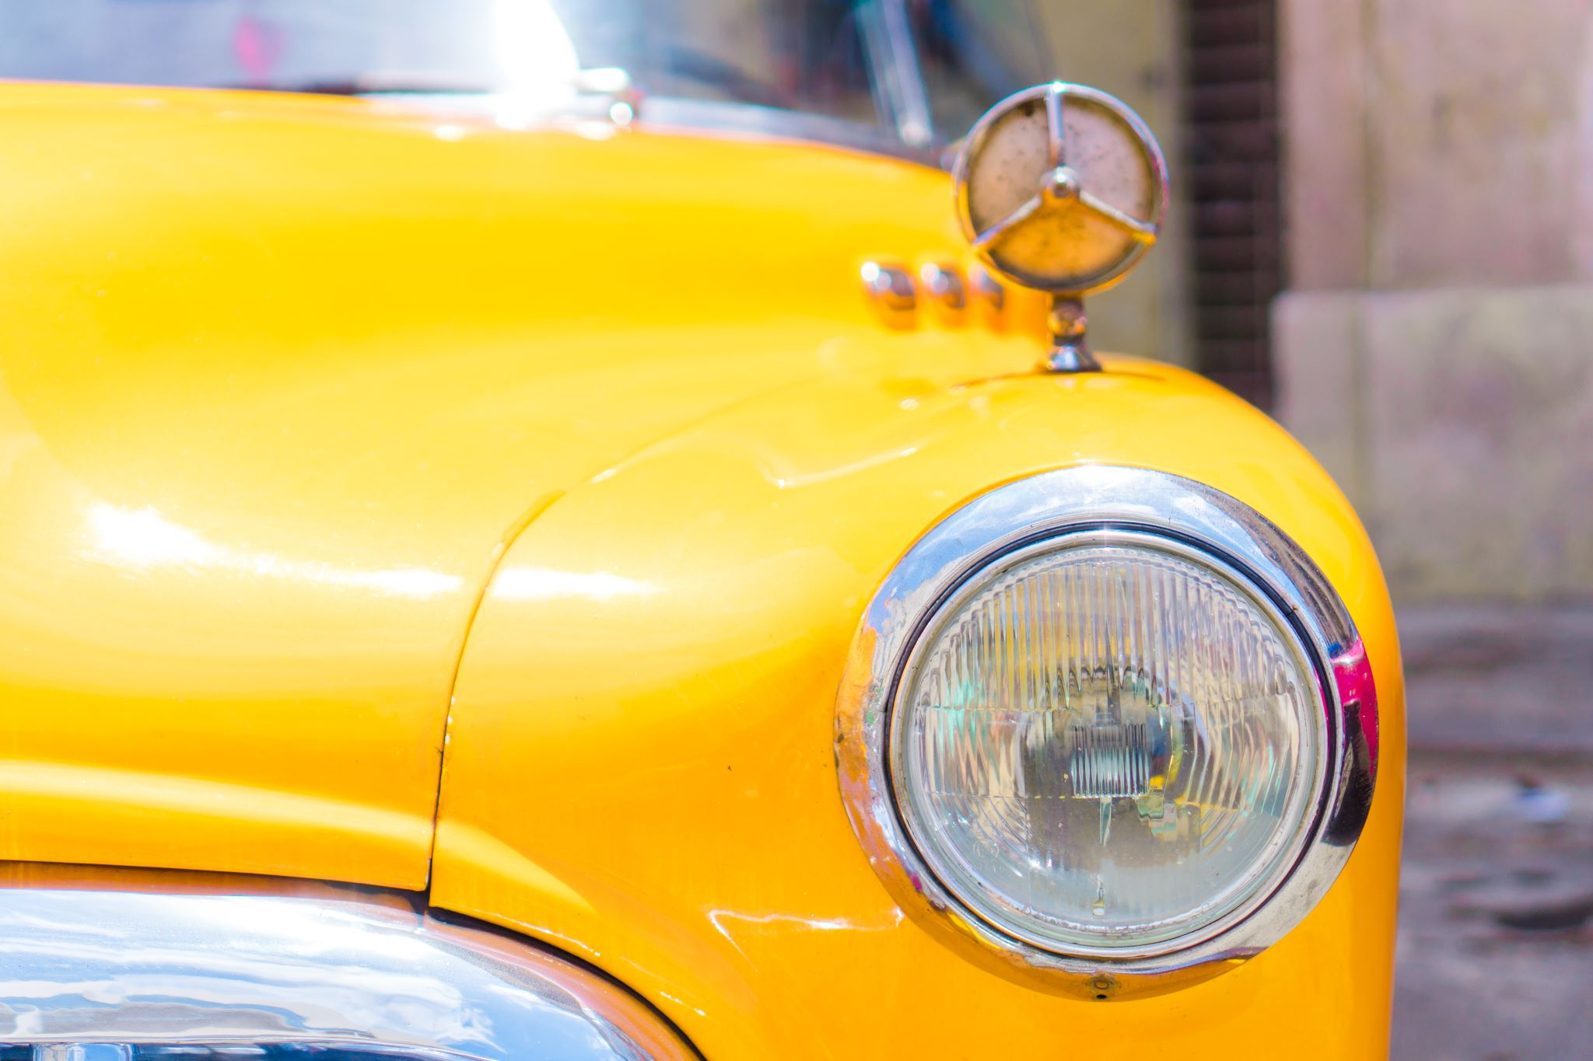
Sistemas expertos - Limitaciones
¿Qué son estas tres imágenes?
Notes:
However these systems had limitations. Most importantly, rules for these systems had to be understood, defined, and programmed by humans. The computer could only do as much as a human engineer was able to understand and turn directly into code.
For some well-defined tasks (ex, creating a system to route customers to sales representatives based on region and vertical) this was fine. But for some tasks that are simple to humans, it was extremely difficult to build rules that a computer could follow
As an example, take a moment to answer in your head what these are pictures of (cat, car, ocean)
For most humans this is quite a simple task. But how would you teach a newborn child, let alone a computer to do what you just did?

Slide 8
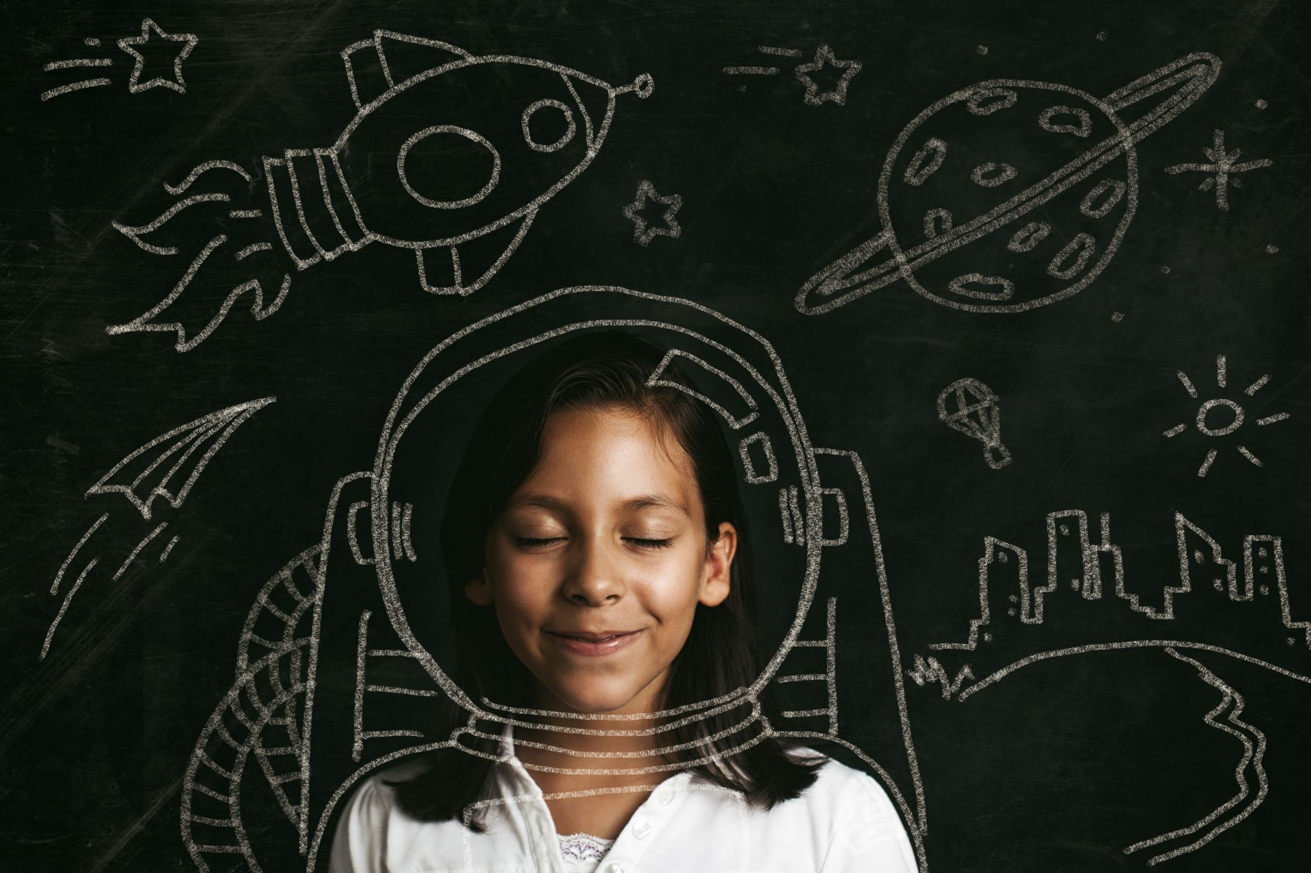
¿Cómo aprenden los niños?
Exponerlos a muchos datos
Darles la «respuesta correcta»
Captarán los patrones importantes por sí solos
Notes:
With children, we expose them to lots of data, and help them learn by supplying the correct answer. A very popular learning technique is “Trail and Error”, where students make a prediction on what is the correct answer, and if they’re wrong, adjust their approach. It turns out that deep learning is very much like this.

Slide 9
La revolución del aprendizaje profundo
Notes:
So there was a period through the nineties and early 2000’s where powerful AI appeared to many to be a pipe dream
Neural networks were being used for some tasks, but fantastic results were not being achieved.
Two major things came together to spawn the era of deep learning that we’re in today

Slide 10
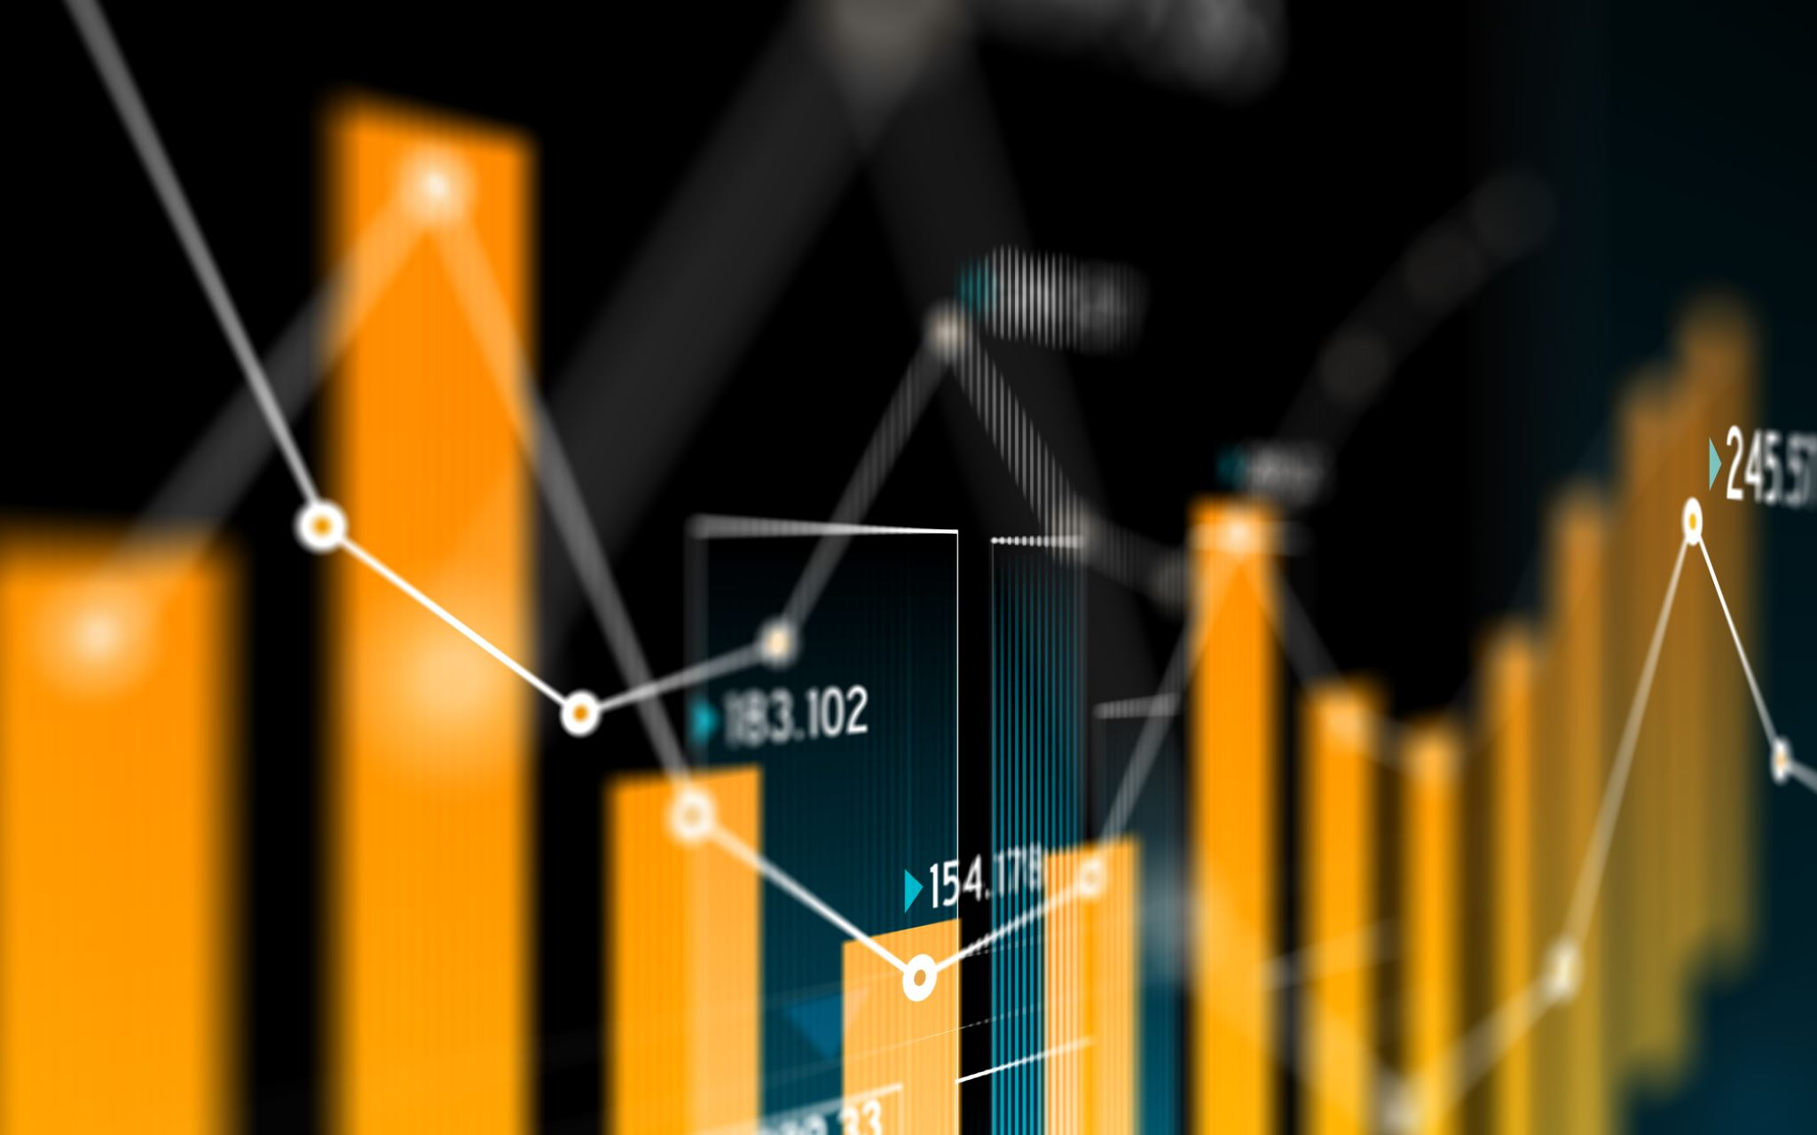
Datos
Las redes necesitan mucha información para aprender
La era digital e Internet han proporcionado esos datos
Notes:
The first is data. In order for a neural network to learn to understand a task, it needs to be exposed to a lot of different data. In order for a neural network to understand what a cat is, it needs to be exposed to a lot of pictures of cats, as well as a lot of pictures of things that are not cats.
The era of the internet has supplied mountains of data for networks to learn on.

Slide 11

Poder computacional
Necesitamos un modo de que nuestro «cerebro» artificial observe muchos datos en un tiempo práctico.
Notes:
The other major factor in the onset of modern deep learning was processing power.
If we’re effectively training an artificial brain, let’s think about our own for a second. How many gigabytes of information do we observe in a given second? What’s the “frame rate” of life? What is the resolution of the human eye?
https://www.discovery.com/science/mexapixels-in-human-eye#:~:text=According%20to%20scientist%20and%20photographer,what%20does%20this%20mean%2C%20really%3F
While modern day AI is impressive, we humans process significantly more data in a second than an AI. One way machines can try to catch up to us humans is with higher computing power.

Slide 12
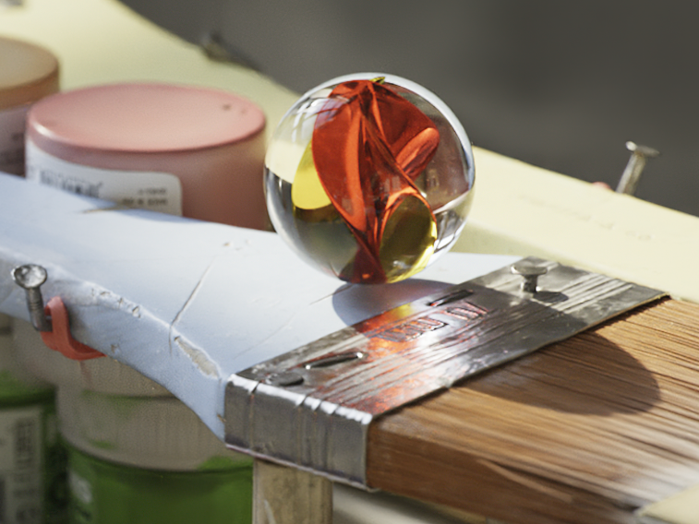
La importancia de la Gpu
Una imagen renderizada
Una red neuronal
Notes:
Left: A computer rendering of a marble: https://www.youtube.com/watch?v=H0_NZDSqR3Y&t=31s
Right: An abstraction of a neural network
It turns out that under the hood, neural networks are matrix multiplication machines. What other types of problems requires many matrix multiplications? Computer graphics! With computer graphics objects are represented as many tiny triangles working together to give the illusion of something more. With animation, simulation, and gaming, these tiny triangles are often transformed and rotated, requiring matrix manipulation.
Since neural networks and graphics are both built on top of the same fundamental mathematical problem, it’s no surprise that the hardware for one can effectively be used for the other.
An especially important invention in tackling this training was the parallel processor. The math required to train a neural network is not especially complex, but calculations must be performed (millions, billions, trillions?) of times, ideally at the same time.
Your average CPU might have 4, maybe 8 cores that allow parallel processing
However, a modern GPU, originally built for the purpose of computing the mathematics of graphics, are parallel processing juggernauts
The GPU that you will be using in this course today has (x thousand cores). These processors are incredibly well suited for deep learning, and NVIDIA is building its GPUs to be specifically architected for training.

Slide 13
¿Qué es el aprendizaje profundo?
Notes:
So what is Deep Learning and what makes it special?

Slide 14
El aprendizaje profundo pone patas arriba la programación tradicional
Notes:
With deep learning, you flip the programming paradigm on its head

Slide 15
Programación tradicional
Creación de un clasificador
Definir un conjunto de reglas de clasificación
1
Programar esas reglas en el ordenador
2
Aliméntelo con ejemplos y el programa utilizará las reglas para clasificar
3
Notes:
For example, normally to build a classifier, you come up with a set of rules, and program those rules
Then when you want classify things, you give it a piece of data, and the rules are used to select a category

Slide 16
Aprendizaje de máquina
Creación de un clasificador
Mostrar modelo de los ejemplos con la respuesta de cómo clasificar
1
El modelo hace conjeturas, nosotros le decimos si acierta o no
2
El modelo aprende a categorizar correctamente a medida que se entrena. El sistema aprende las reglas por sí solo.
3
Notes:
With deep learning, we first need a list of variables: inputs and their corresponding outputs. We don’t need to know the relationship between the inputs and the outputs, but the more accurate we can observe their values, the better. We’ll call this list of examples the dataset.
We then train a model by showing it the dataset and the correct outputs
The model keeps taking guesses, and finds out if it was right or not
It slowly learns to correctly categorize over the course of training
The fundamental difference is that instead of humans needing to identify and program the rules, a deep learning algorithm will learn them on its own

Slide 17
Se trata de un cambio fundamental
Notes:
This is a fundamental shift in the way we can build software systems

Slide 18
Cuándo elegir el aprendizaje profundo
Programación clásica
Aprendizaje Profundo
Si las normas son claras y directas, a menudo es mejor programarlas.
Si las reglas son matizadas, complejas, difíciles de discernir, utilice el aprendizaje profundo
Notes:
Deep learning is not always the right choice. If the decisions that need to be made to produce a result are very clear, it’s likely that it should just be programmed in the traditional way
However, if the rules are nuanced or complex, and humans would have a hard time describing them, let alone programming them, deep learning is a great choice

Slide 19
Aprendizaje profundo comparado con otras IA
Profundidad y complejidad de las redes
Hasta miles de millones de parámetros (y creciendo)
Muchas capas en un modelo
Importante para aprender reglas complejas
Notes:
One thing that separates Deep Learning from traditional machine learning is the depth and complexity of the networks that are used. For especially complicated tasks such as natural language understanding (used for translations, text generation, other) networks can have billions of parameters.
The deep in deep learning refers to the many layers in a model that learn the important rules necessary for completing a task. These are often called hidden layers.
https://arxiv.org/ftp/arxiv/papers/1901/1901.06032.pdf

Slide 20
Cómo el aprendizaje profundo está transformando el mundo
Notes:
Deep learning has only been a major factor in the last decade or so, but it has had huge impacts on many industries

Slide 21
Visión por ordenador
Robótica y fabricación
Detección de objetos
Coches autónomos
Notes:
The field of Computer Vision has been around long before the field of Deep Learning, but because there are now more and more tagged high quality images available, Deep Learning is having a large influence.
The goal of computer vision is to teach machines to see and perceive images the way that humans do. Thanks to the complexity of our eyes, not to mention the processing our brains do with these images, this is no easy task!

Slide 22
Procesamiento del lenguaje natural
Traducción en tiempo real
Reconocimiento de voz
Asistentes virtuales
Notes:
Natural language processing, which we’ll also touch on in this course has helped make huge shifts, for example in highly accurate, real time language translation, as well as voice recognition and virtual assistants

Slide 23
Sistemas de recomendación
Selección de contenidos
Publicidad dirigida
Recomendaciones de compra
Notes:
Recommender systems based on deep learning fuel the internet with content curated feeds such as facebook, music like spotify, video like youtube and netflix, as well as targeted online advertising and shopping recommendations (Amazon)

Slide 24
Aprendizaje por refuerzo
AlphaGo vence al campeón mundial de GO
Los robots de inteligencia artificial vencen a los videojugadores profesionales
Robots bursátiles
Notes:
Reinforcement learning has achieved incredible results in matching human expert performance, such as the AI alpha-go, which beat the world champion in what is considered one of the most difficult and complex games in the world. AI bots are now also taking on world experts in complex videogames such as Starcraft and DOTA
The list goes on, and we’ll talk about some exciting models and advancements later in the course

Slide 25
Panorama de la unidad

Slide 26
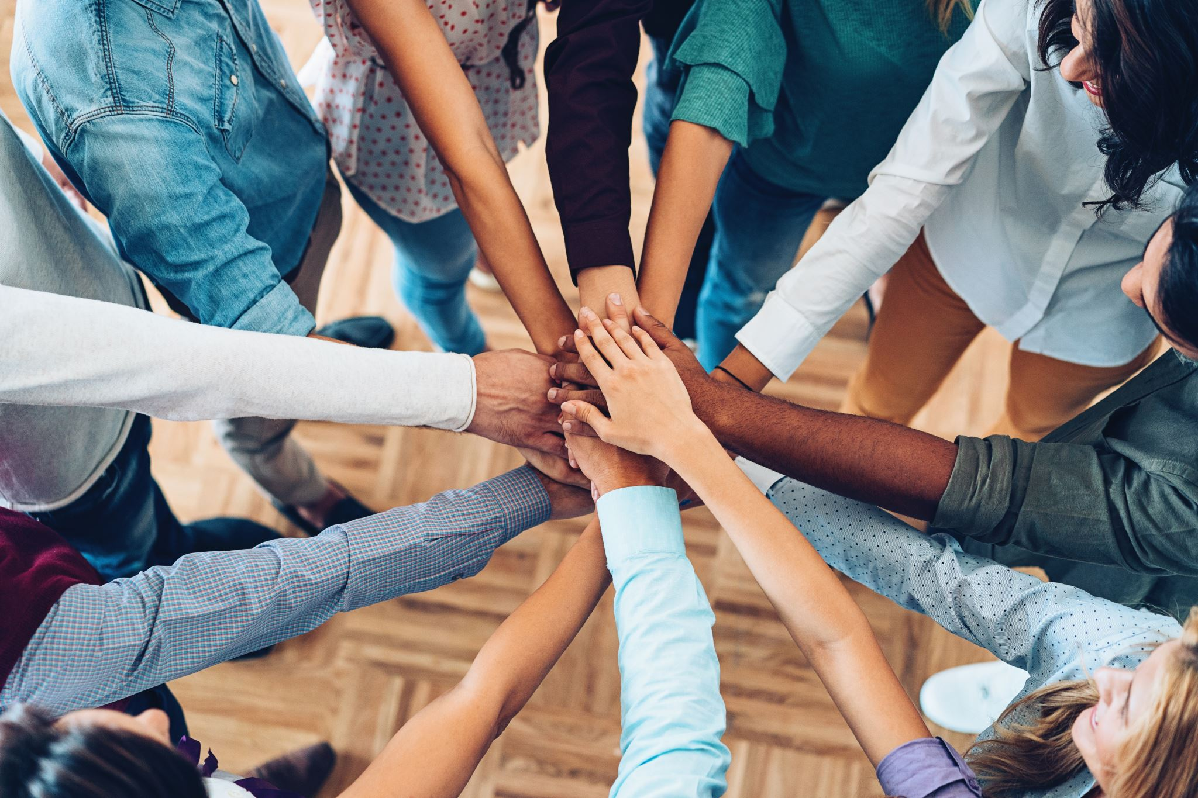
Ejercicios prácticos
Sentirse cómodo con el proceso de aprendizaje profundo
Exposición a diferentes modelos y tipos de datos
Obtener un salto de arranque para hacer frente a sus propios proyectos
Notes:
The course is split up into a series of exercises to get you comfortable with deep learning
We’re going to be exposing you to some different models, as well as different datatypes
With only a day, we can’t expose you to everything, but the goal is to give you a significant jump-start, so that you’ll be able to have a foundation to pursue your own projects moving forward

Slide 27
Estructura de la unidad
“Hello World” del Aprendizaje Profundo
Entrenar un modelo más complicado
Nuevas arquitecturas y técnicas para mejorar la performance
Modelos pre-entrenados
Transferencia de aprendizaje y ajuste fino
Notes:
Here’s the structure of the course:
- Train your first model (computer vision)
- Train a more complicated model
- Introduce new architectures and techniques to improve model performance and accuracy
- Using your trained model to make new predictions
- Using state-of-the art pre-trained models to solve a deep learning challenge
- Transfer the learning of one model to another to solve difficult deep learning challenges
- Train a language model to gain exposure to new types of data and architectures
- Appendices:
- Play around with cool models from around the web
- Learn to set up a deep learning environment to tackle your own projects

Slide 28
Plataforma del curso
Servidor en nube con GPU
Plataforma JupyterLab
Cuadernos Jupyter para codificación interactiva
Notes:
In this course you will be connected to a server that contains a very powerful GPU.
Deep learning training is possible to run on a CPU, but due to the computational complexity of the training, it is extremely beneficial to have the massive parallel processing that GPUs provide. Without it, you would be waiting around a lot, and we could not fit this course into a single day.
You will be connected to this powerful server through a software platform called JupyterLab. Jupyter lab is a platform that among other things runs jupyter notebooks. In these notebooks you’ll be able to run and edit Python code to accomplish the goals of the exercises

Slide 29




Software de la unidad
Principales plataformas de aprendizaje profundo:
TensorFlow + Keras (Google)
Pytorch (Facebook)
MXNet (Apache)
Utilizaremos TensorFlow y Keras
Buena idea para ganar exposición a otros en el futuro
Notes:
There are a few big players in the deep learning space when it comes to frameworks
The three most commonly used are Tensorflow + Keras (google), Pytorch (facebook), and MXNet (apache)
They are all great choices, and neither of them is a clear winner
In this course we’ll be using TensorFlow and Keras, but as you continue your deep learning journey, we recommend that you gain some exposure to the others as well

Slide 30
Primer ejercicio: Clasificar cifras manuscritas

Slide 31
Hola Redes Neuronales
Entrenar una red para clasificar correctamente los dígitos manuscritos
Tarea históricamente importante y difícil para los ordenadores
Intenta aprender como una red neuronal
Exponerse al ejemplo e intentar descifrar las reglas de funcionamiento.
Notes:
Before we get too much into theory and the specifics of deep learning, we’re going to act like an AI and play with a neural network right away. See if you can figure out how we went about constructing the model. Feel free to experiment and alter the code. You can always restart the GPU instance in order to get a fresh start if your curiosity gets a little too crazy.
You’ll start by teaching a model to understand and categorize hand-written digits
Recognizing handwriting is a historically important task in the history of AI, and one that is especially well suited to deep learning
You’ll be working on a dataset called MNIST, which contains 70,000 images of handwritten digits
You might feel that there’s a lot of information to absorb in this first exercise, but be patient with yourself, and don’t worry if it’s not all perfectly clear right away. You’ll be exposed to the steps of training several times over the course, and will gain an understanding through practice
The main goal is just to give you a sense of what training looks like, and we’ll fill in some of the details as we move on

Slide 32
Let’s go!
https://colab.research.google.com/drive/1QkrUCxC0CKcFpllFcxP4M2nIB18iYAux?usp=sharing
Notes:
We’re excited to have you here. Let’s get started.

